Slide 2
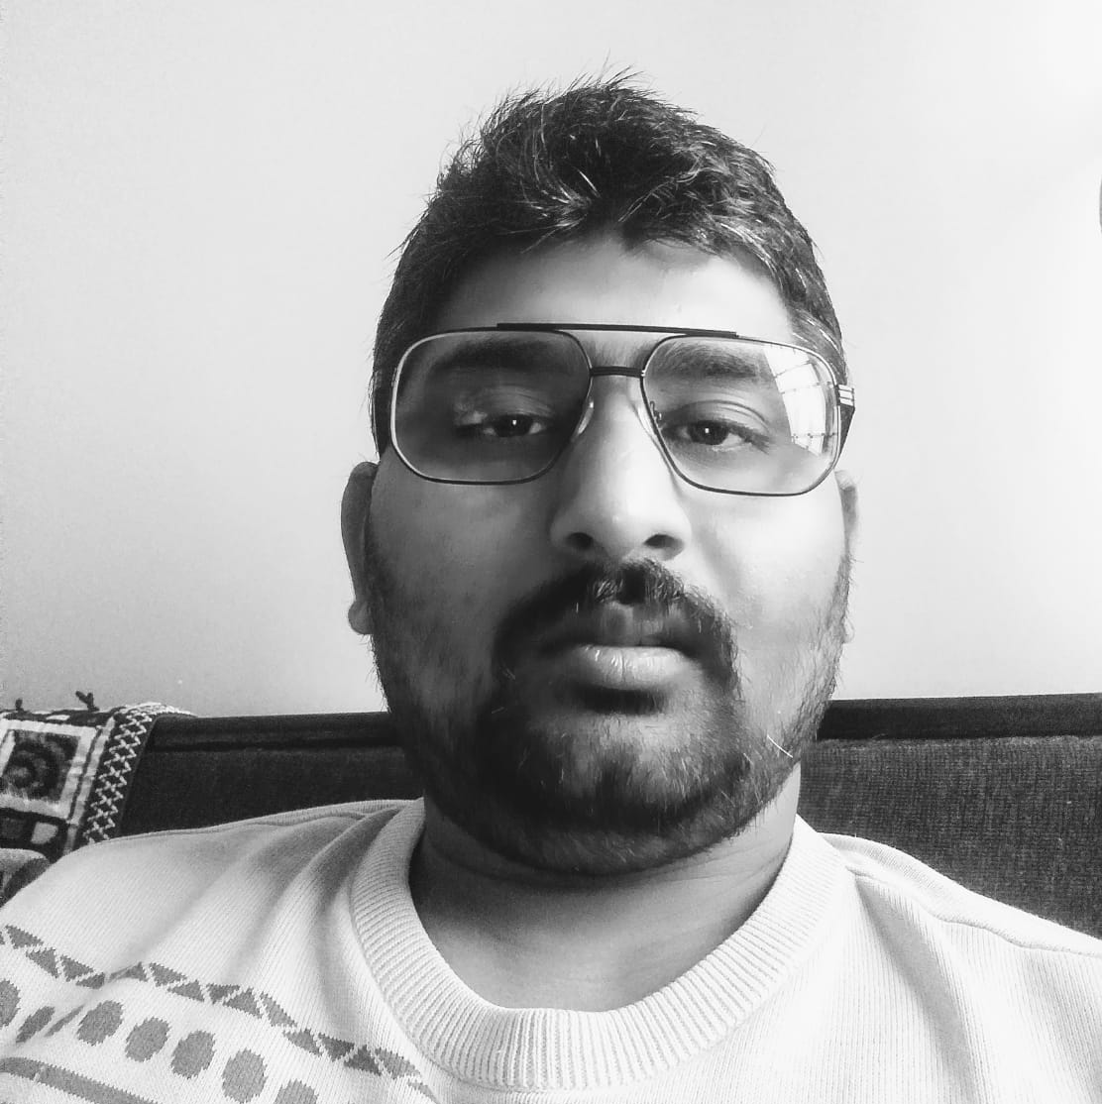
Session Details
Session Confidential Computing & Data Protection
Lalit Rawat
Cloud Solution Architect
Azure MVP, Mentor, Author

Slide 8
Next Session
Session Confidential Computing & Data Protection
Lalit Rawat
Cloud Solution Architect
Azure MVP, Mentor, Author

